Slide 1
NUCAPS and Satellite MW Observations of the 27 December 2023 UK Severe Storm Outbreak
Ken Pryor
NESDIS/STAR/SMCD

Slide 2
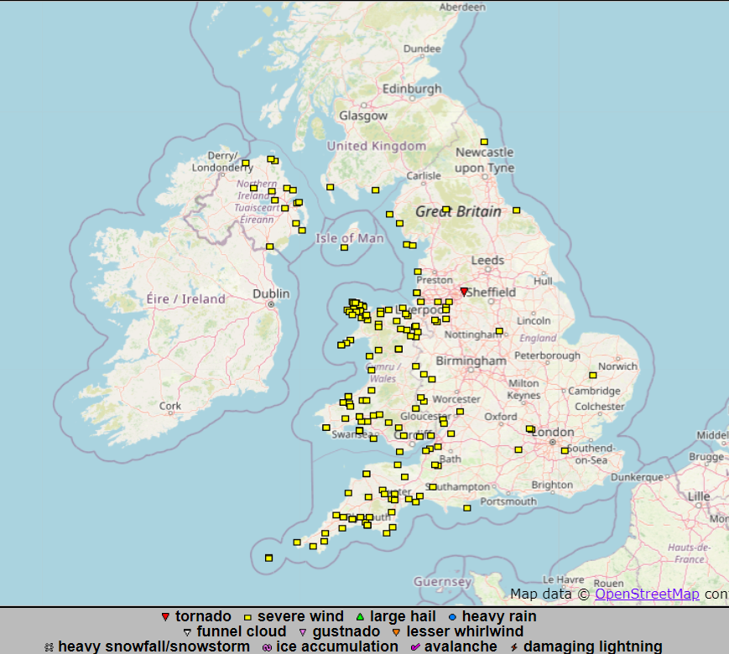

Slide 3
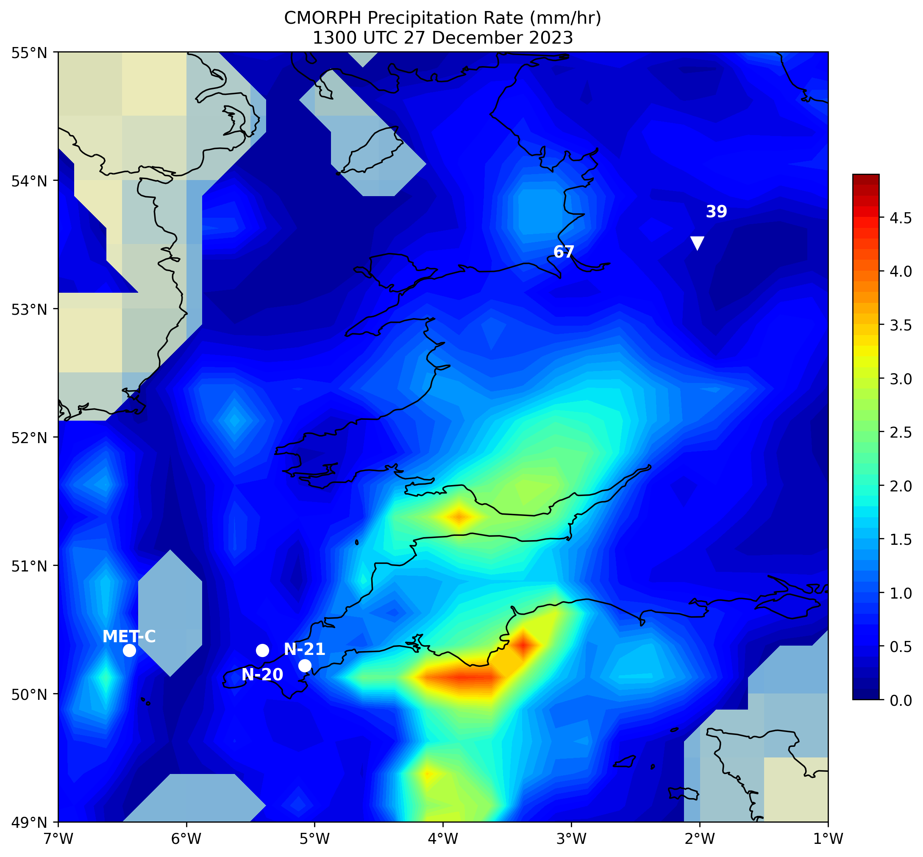
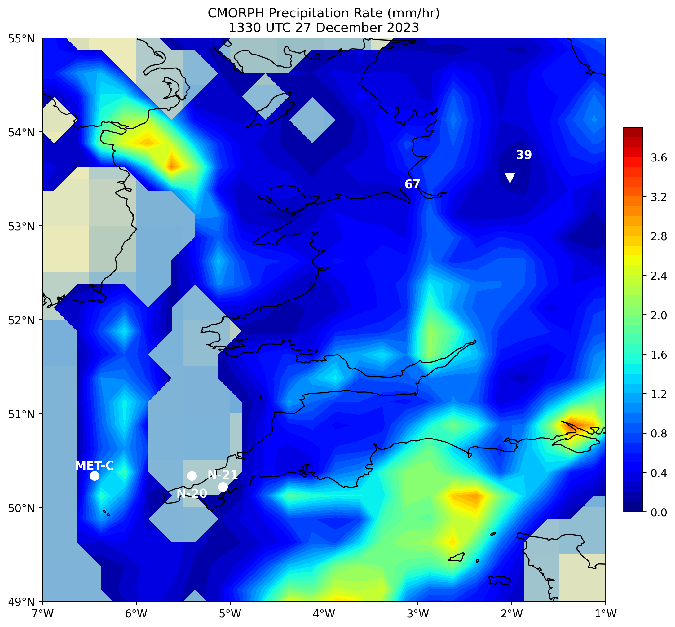

Slide 4
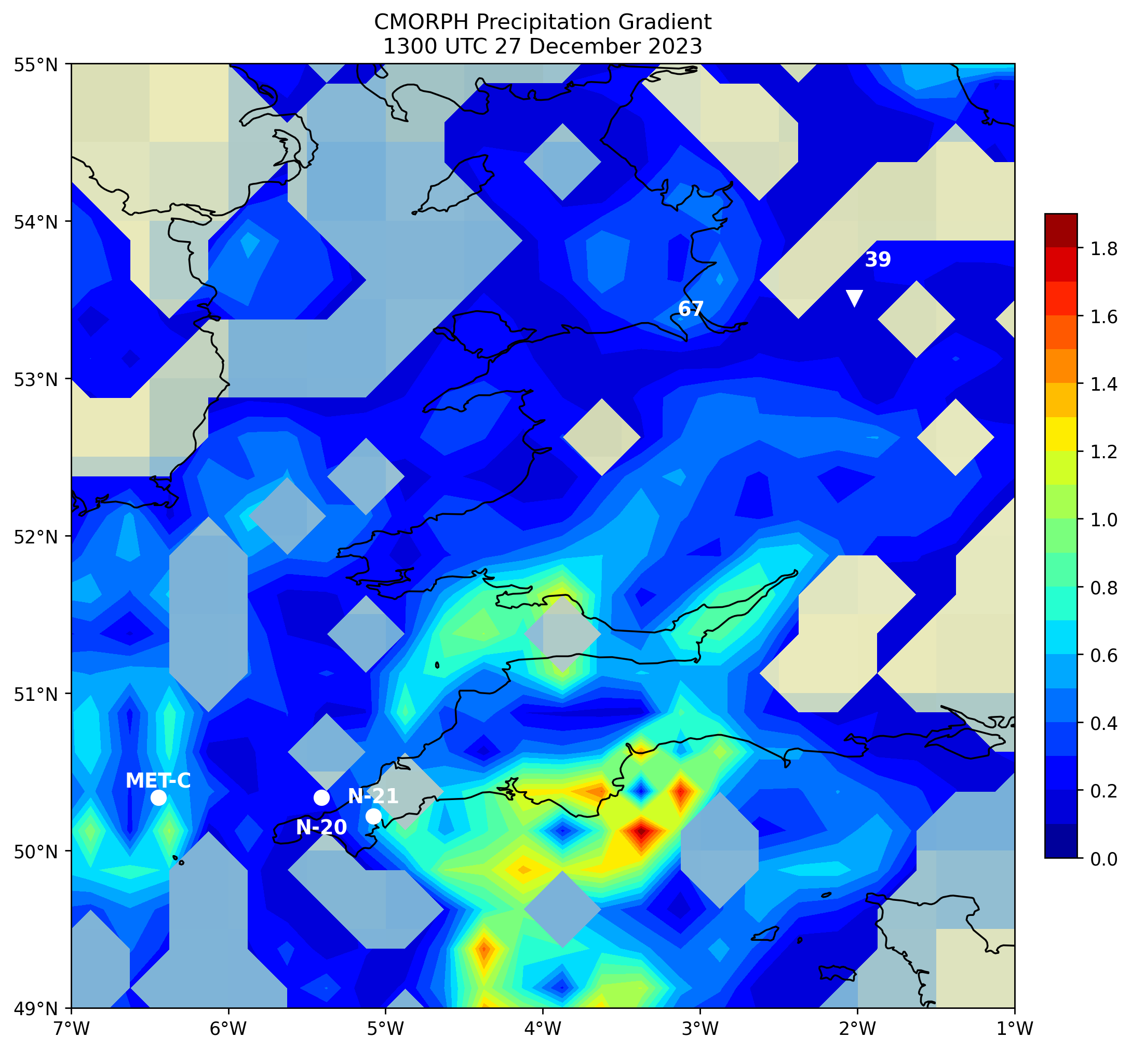
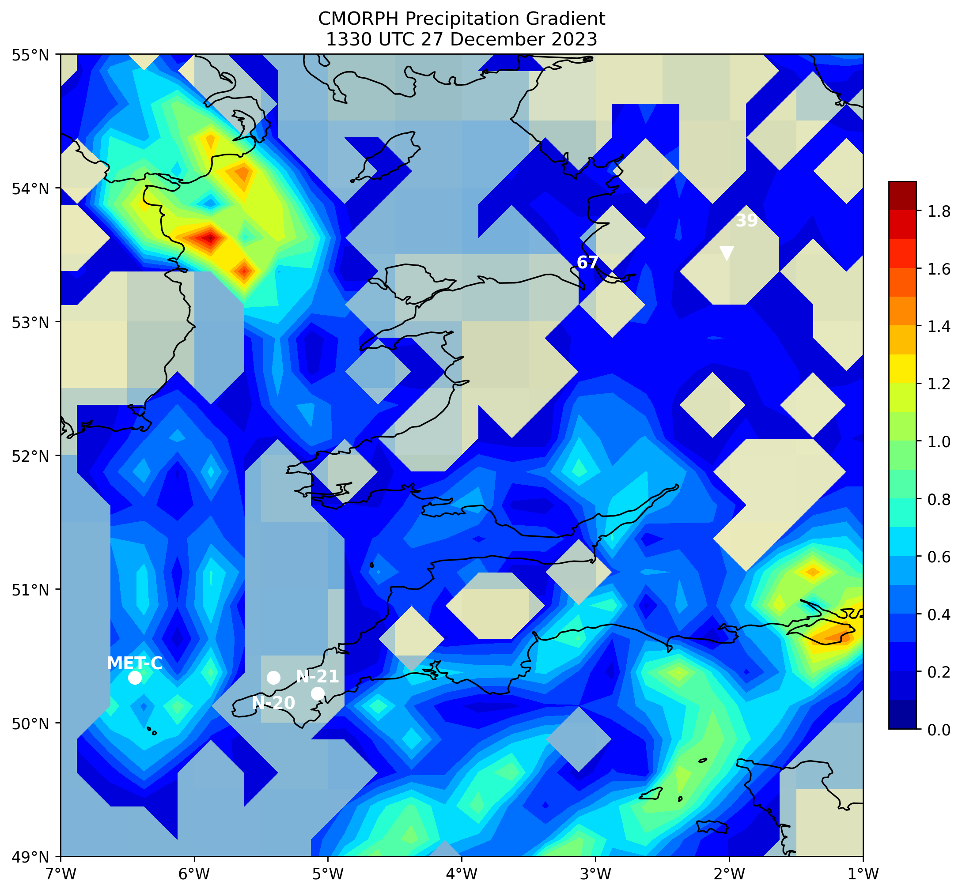

Slide 5
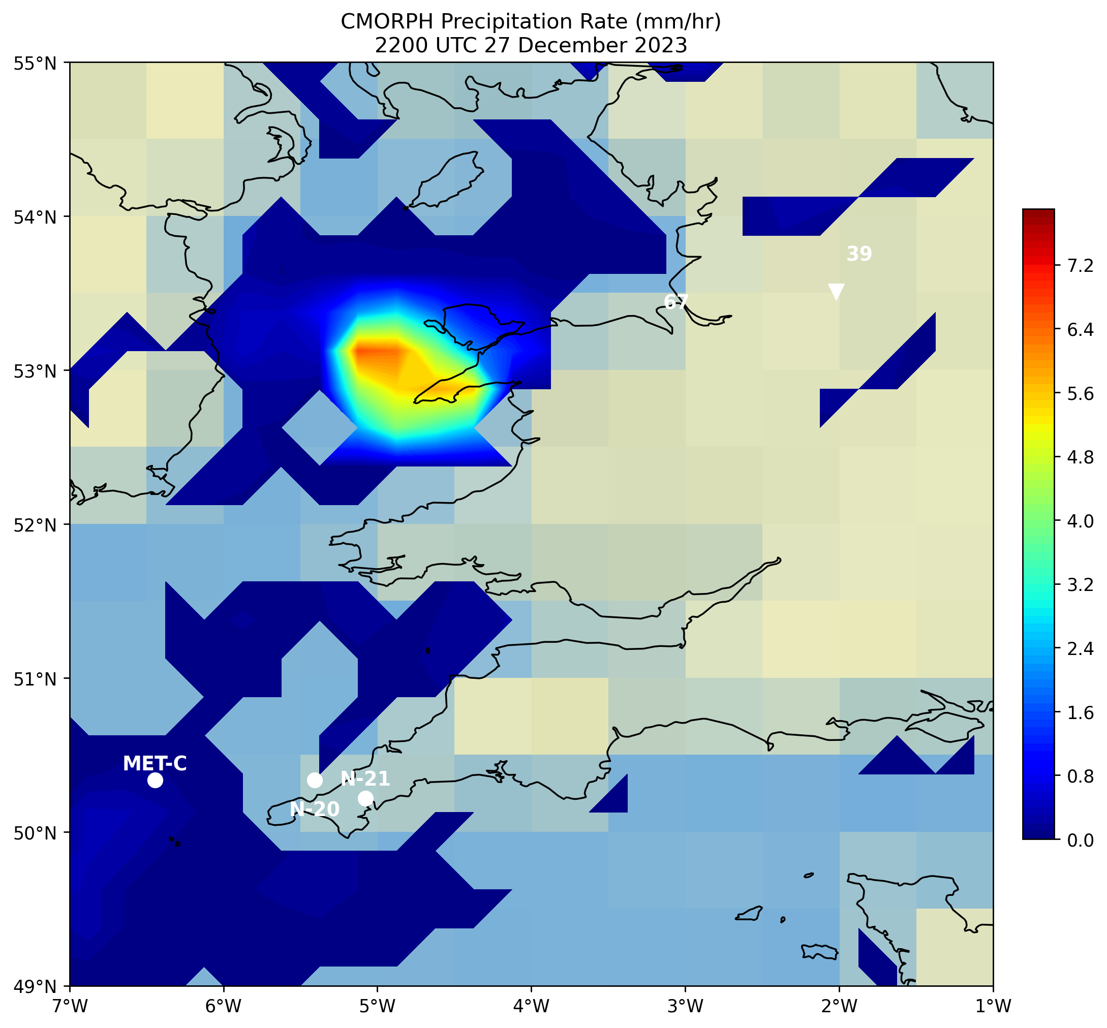
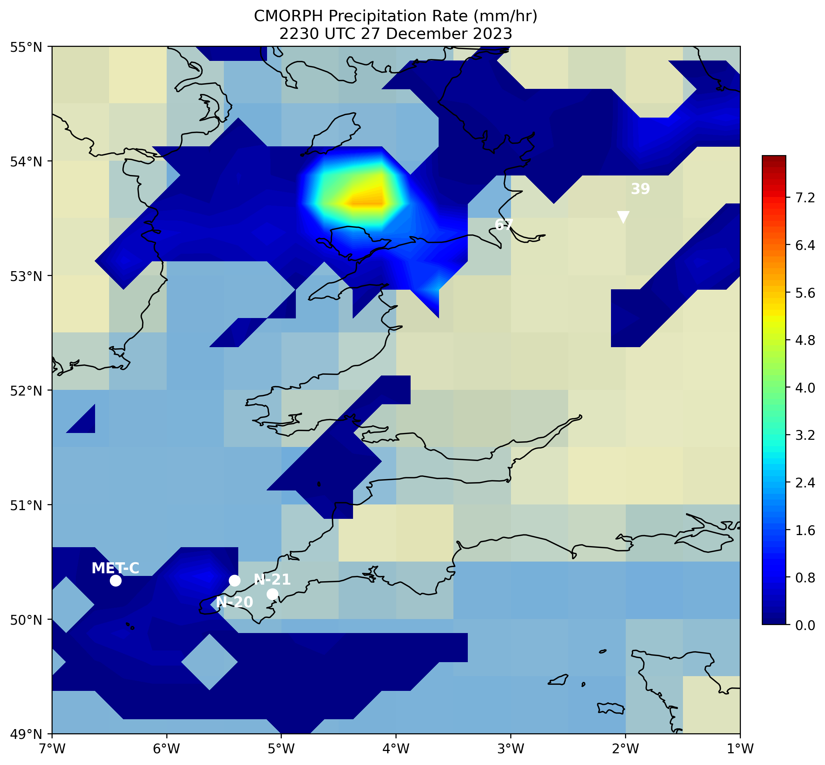

Slide 6
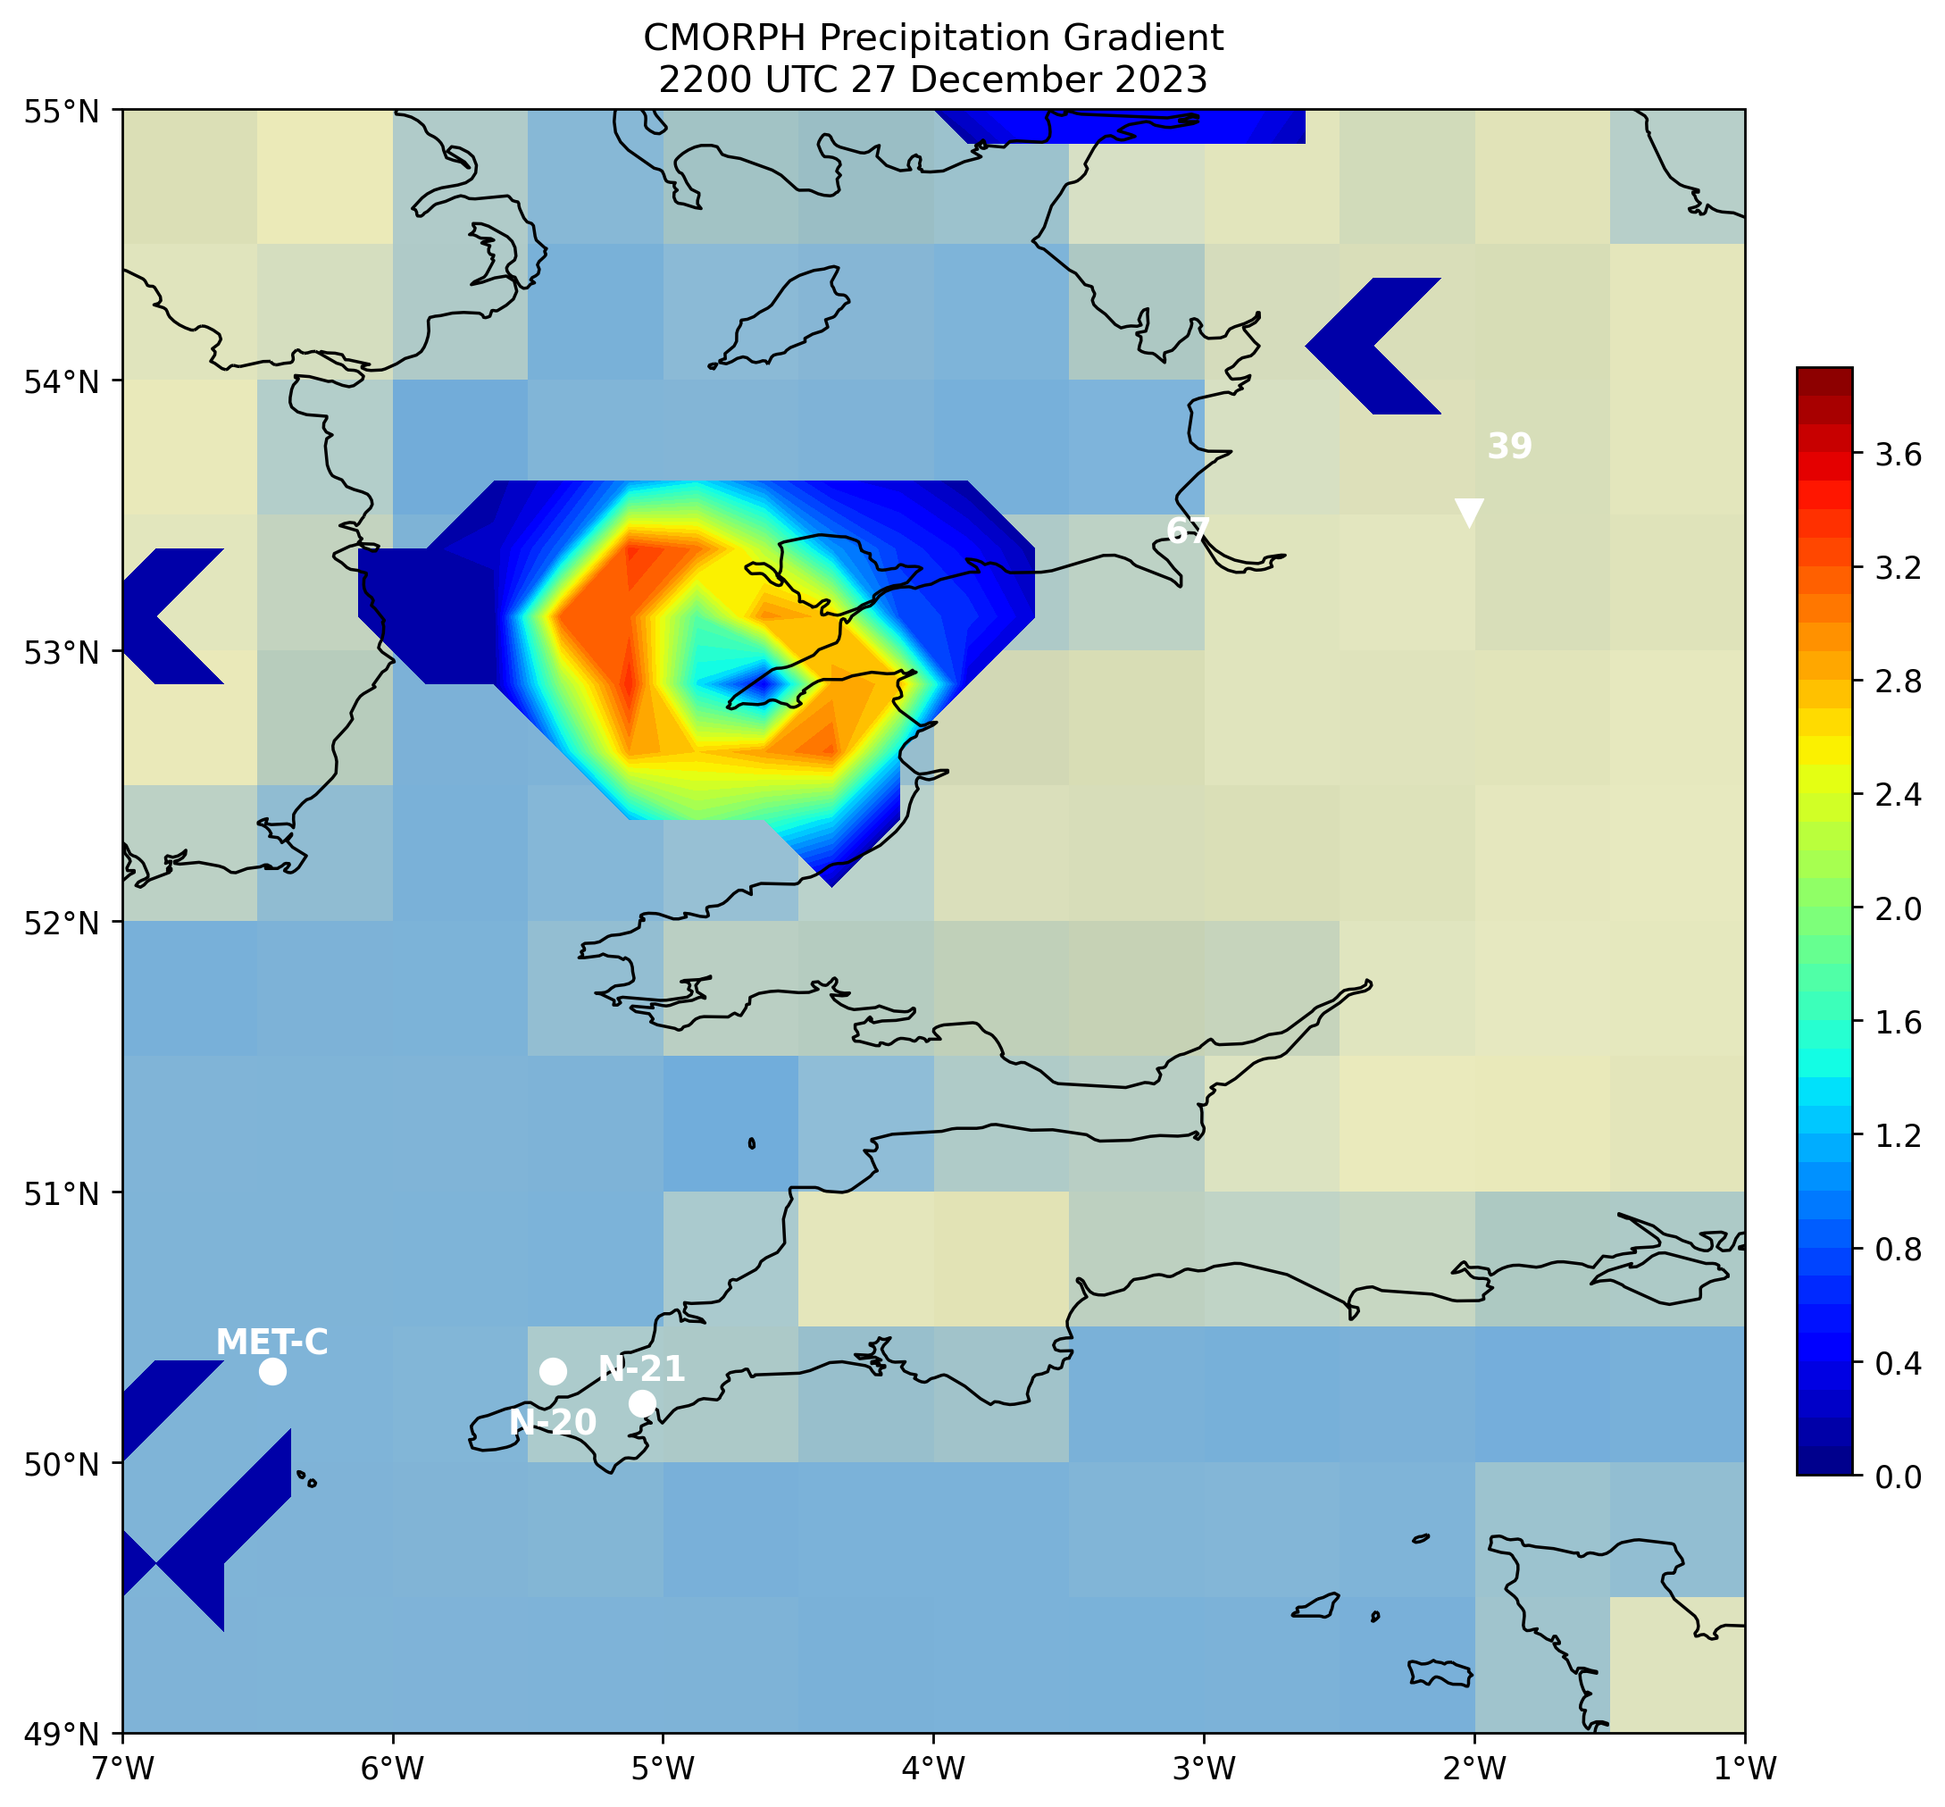
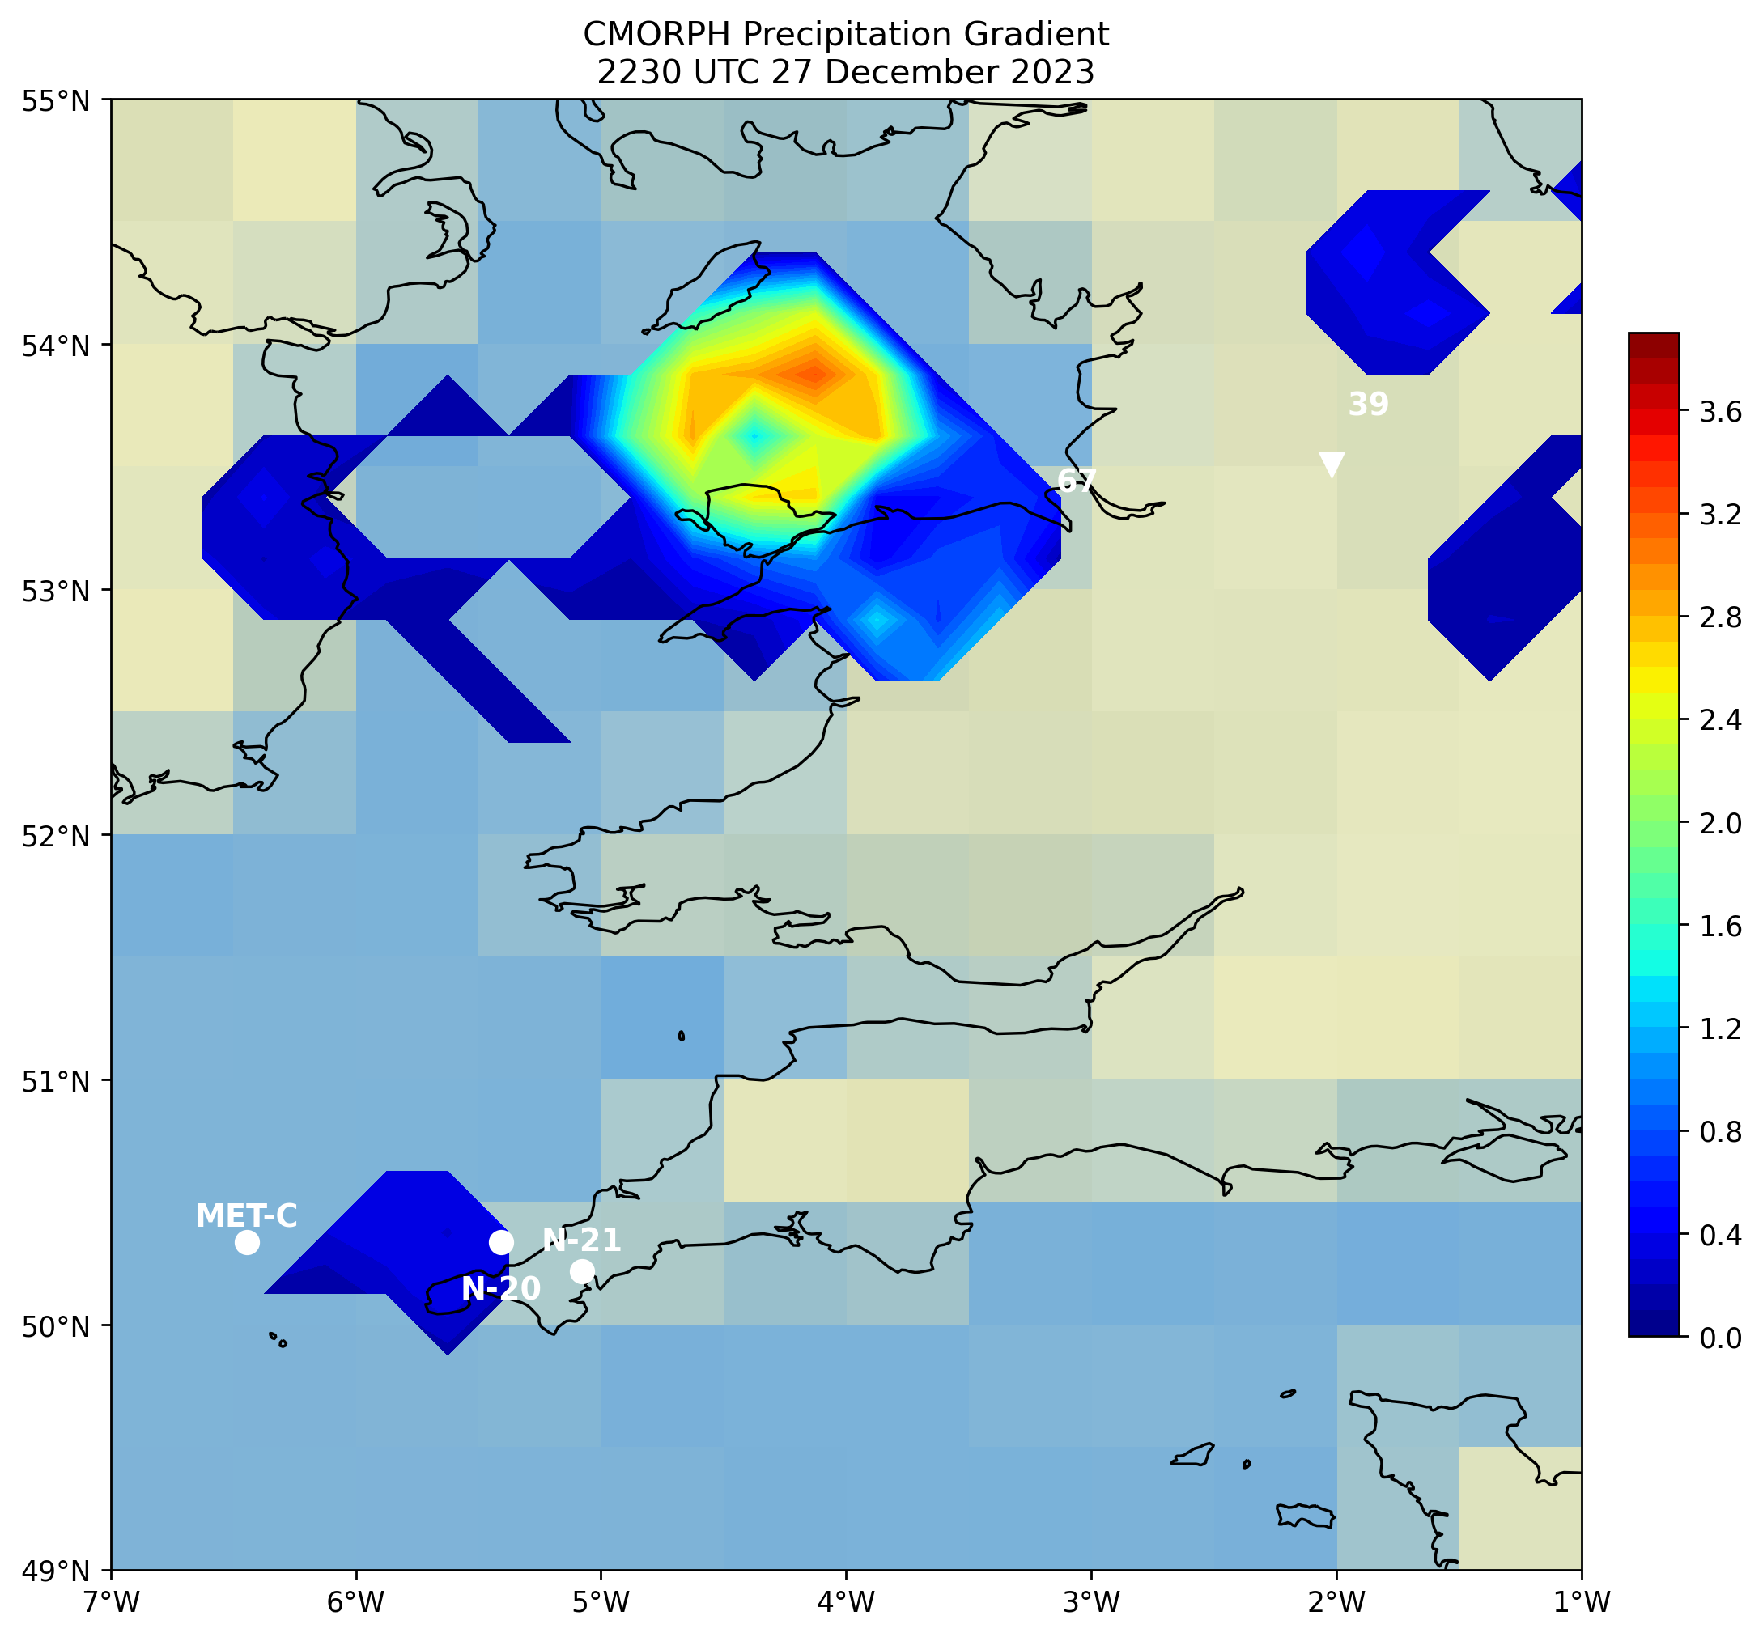

Slide 7
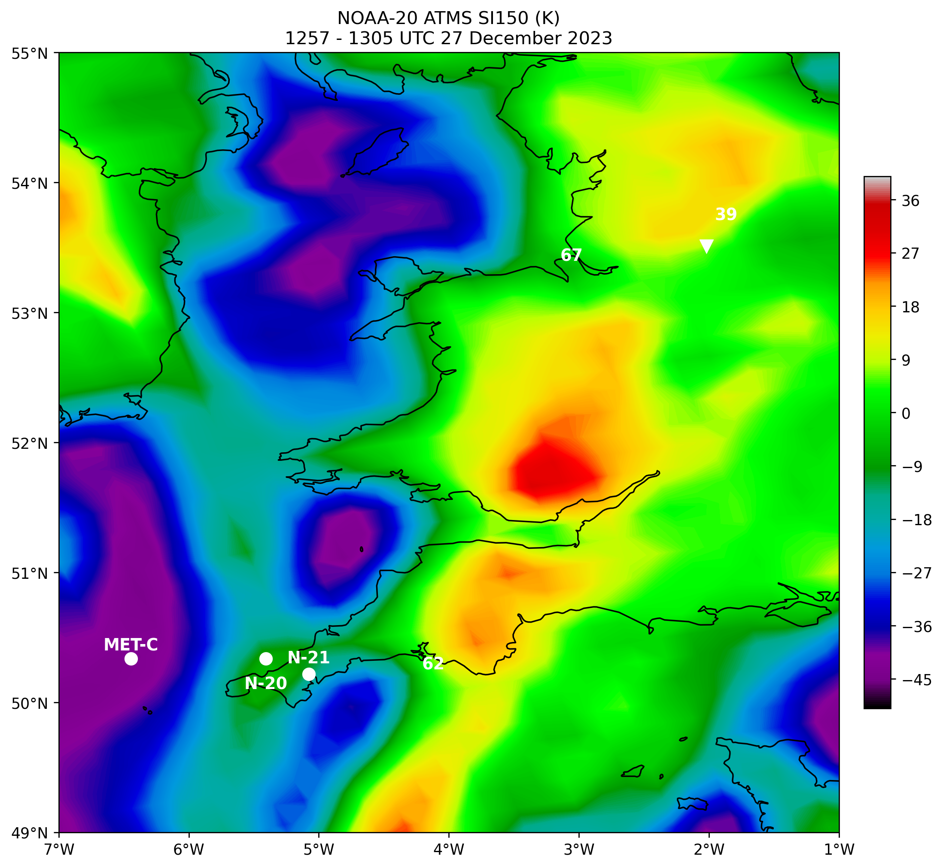
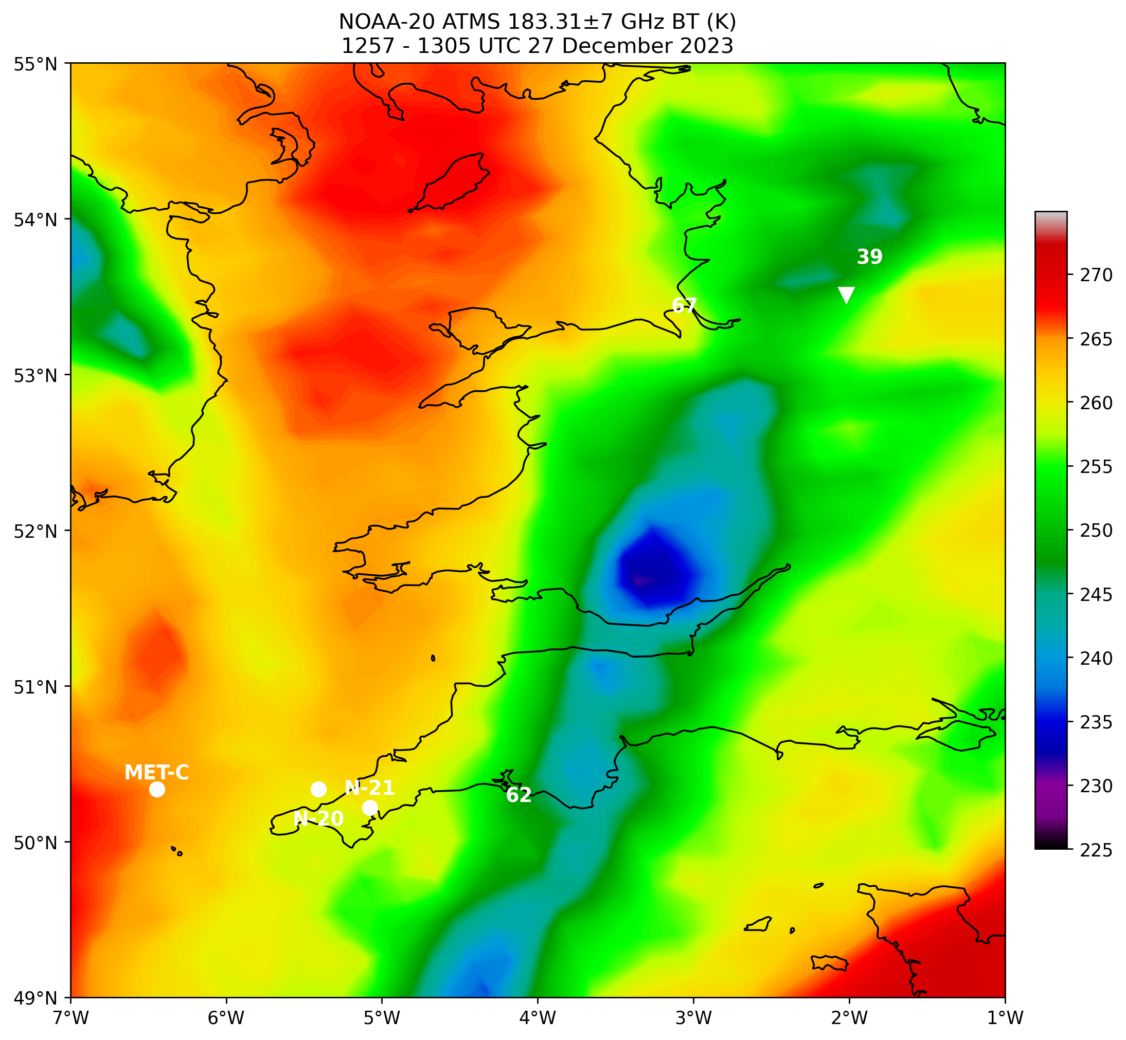
Squall line
Squall line

Slide 8
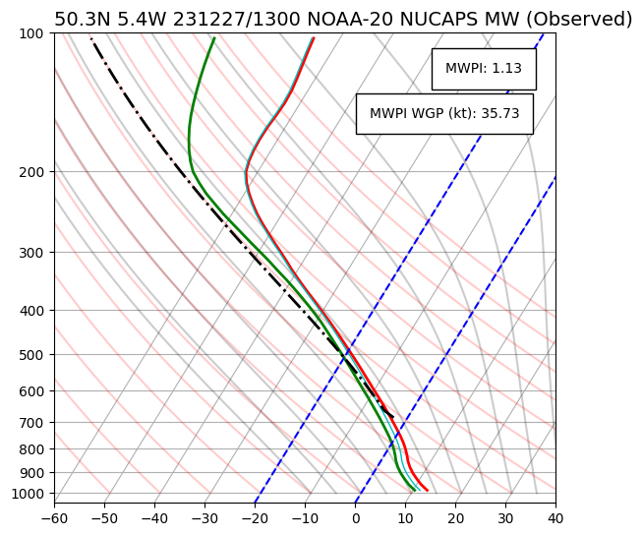
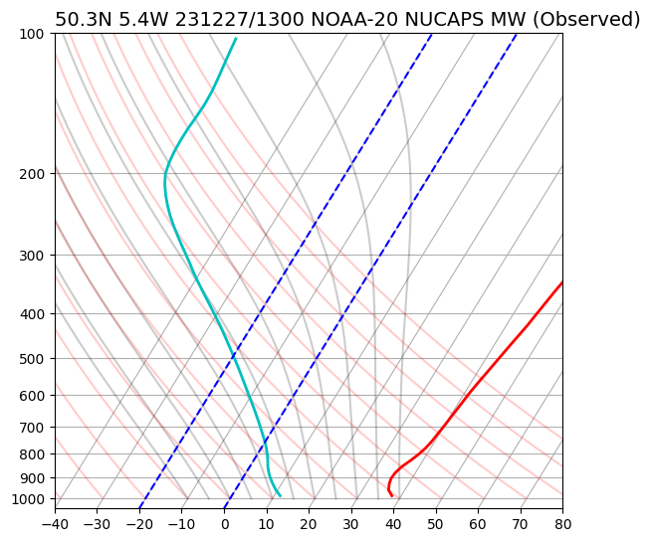
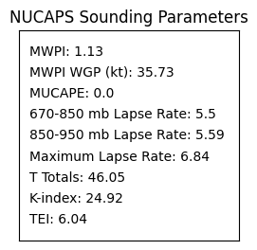
Wetbulb
θ_{e}
Conditional/potential instability
15 km NW of Camborne, Cornwall, UK

Slide 9
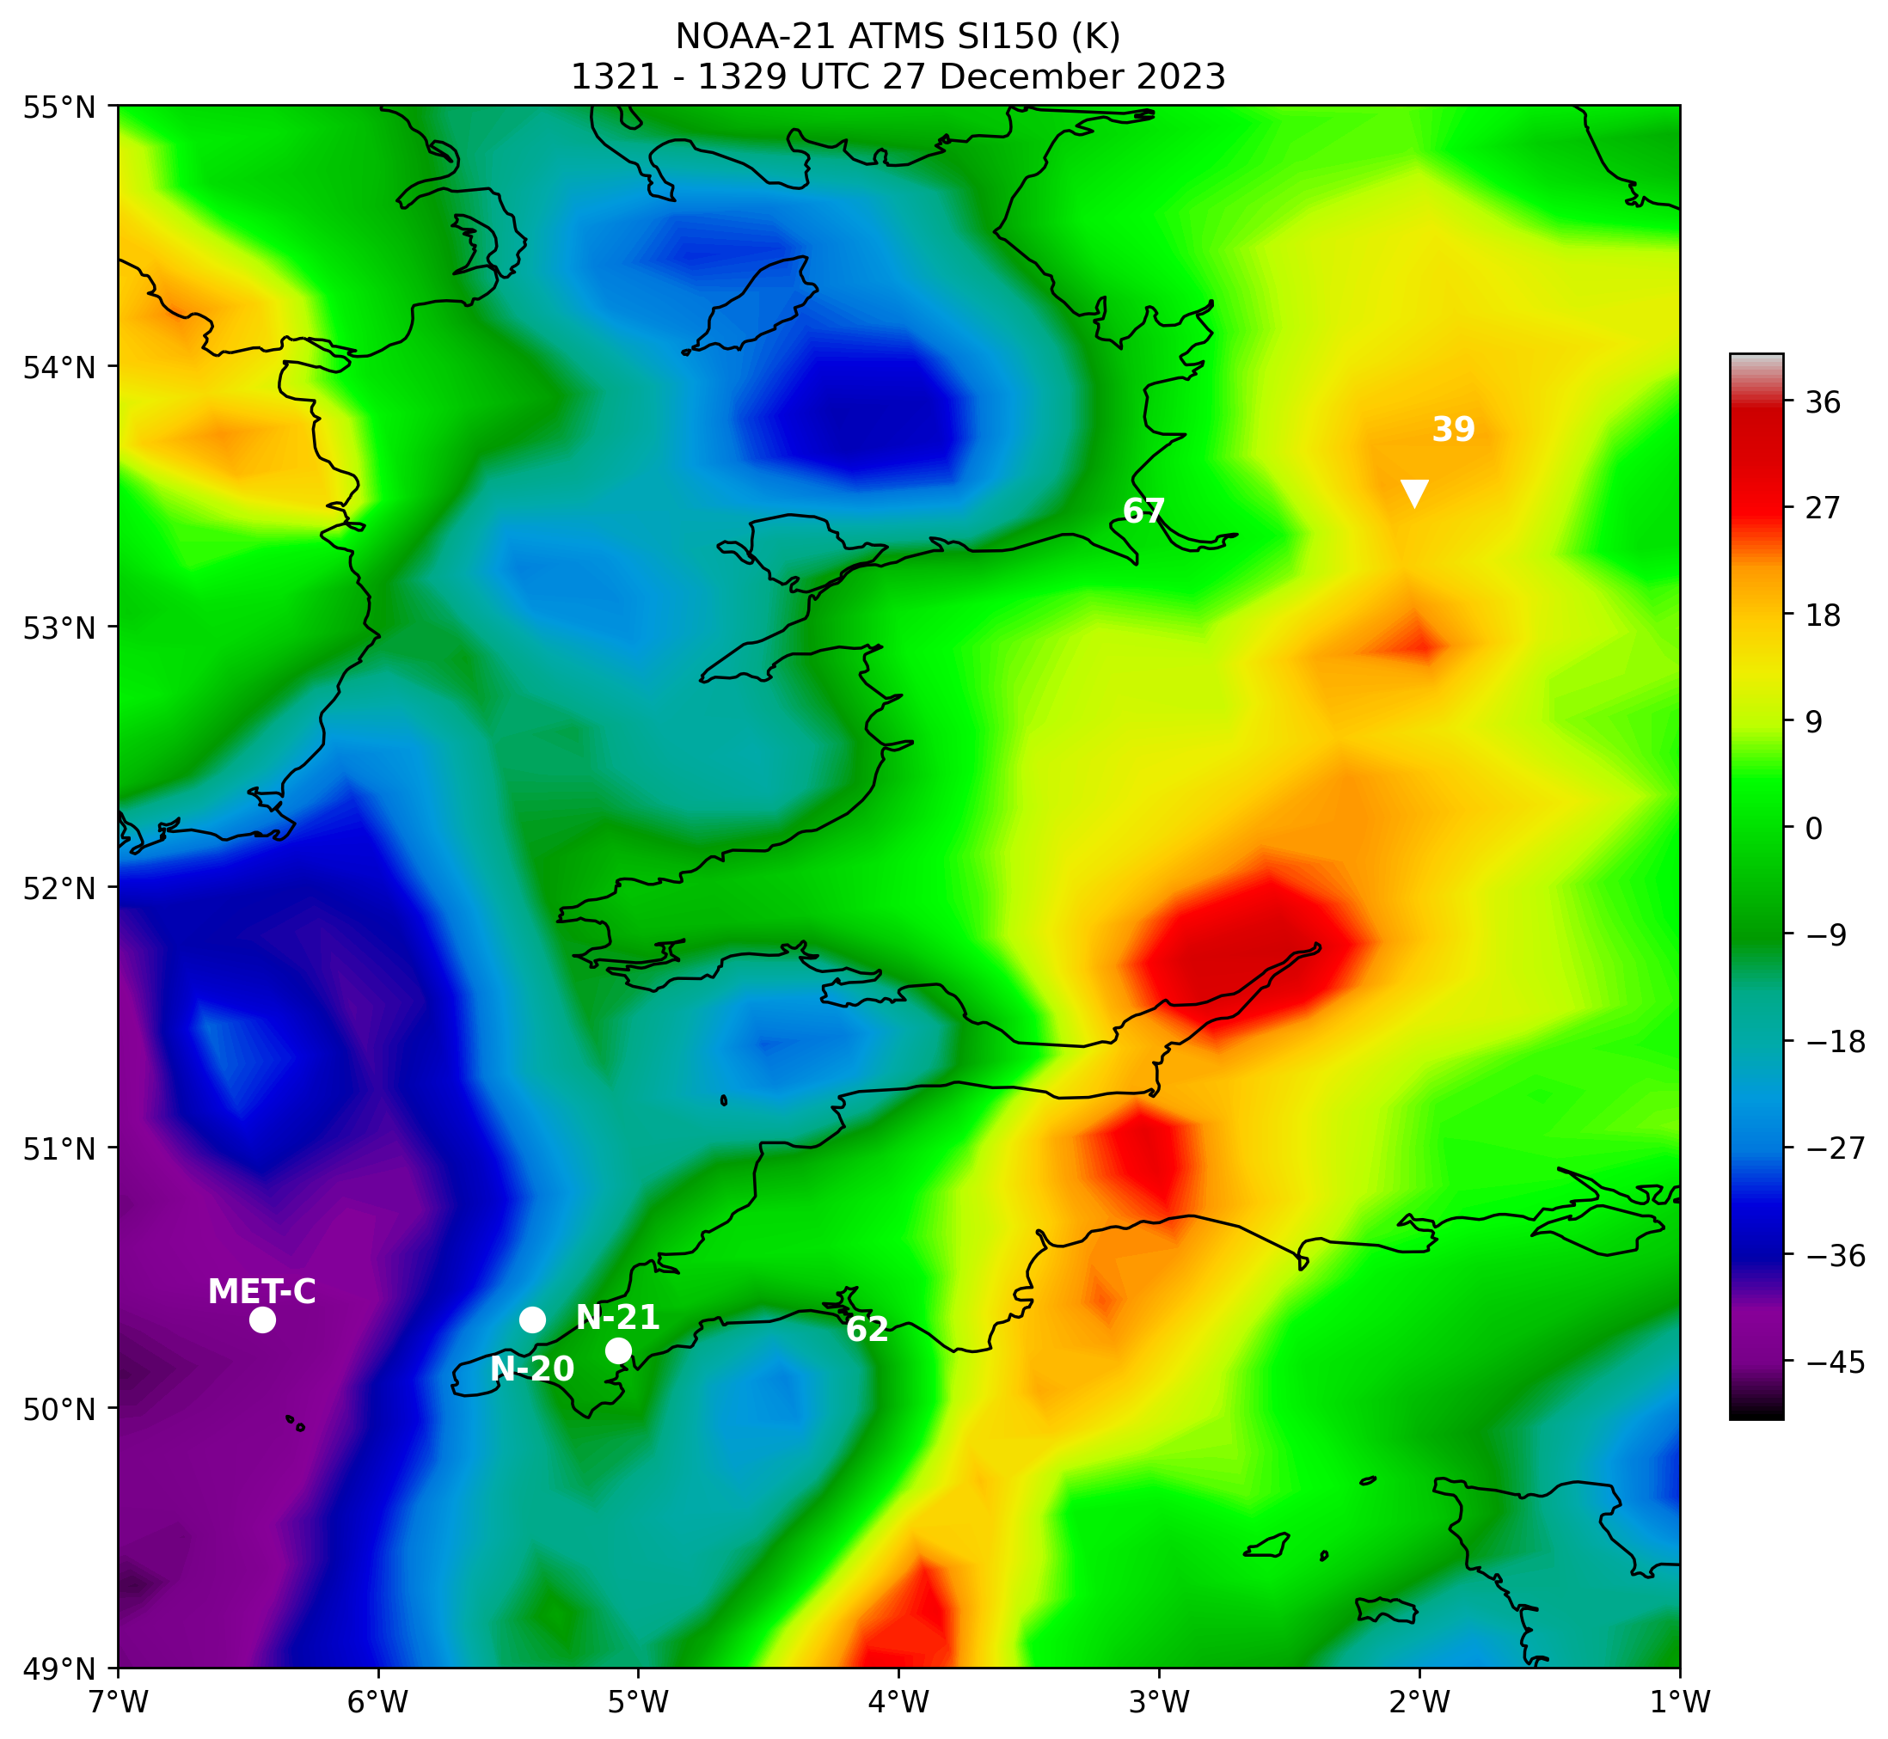
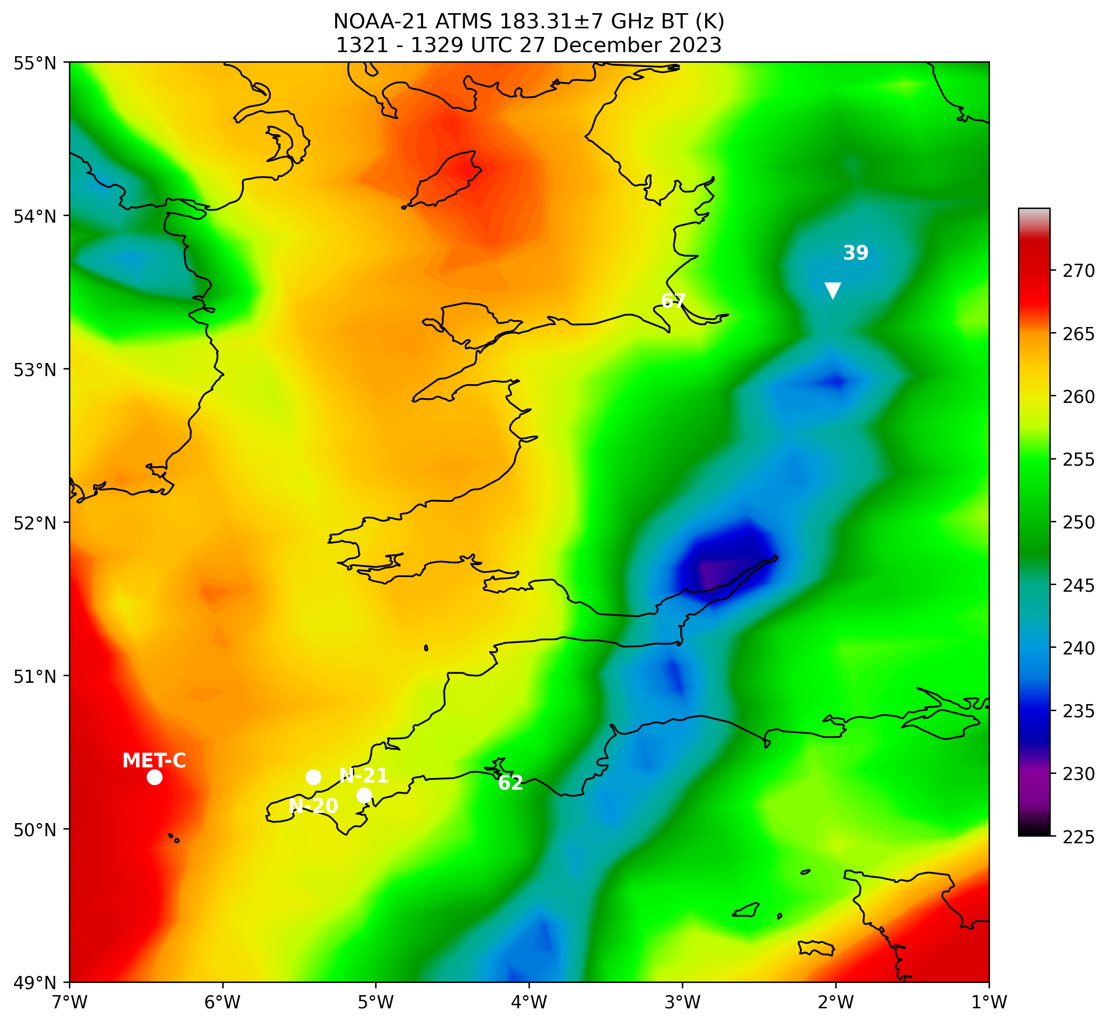
Squall line
Squall line

Slide 10
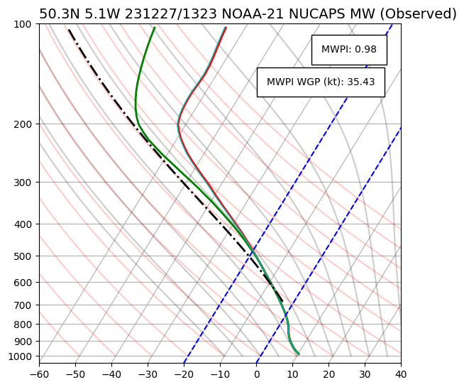
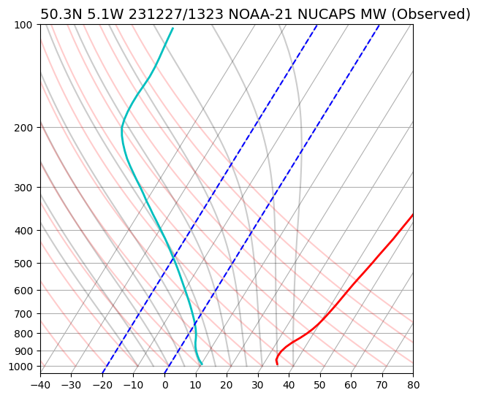
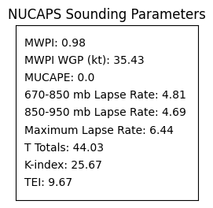
Wetbulb
θ_{e}
Conditional/potential instability
Over Falmouth, Cornwall, UK

Slide 11
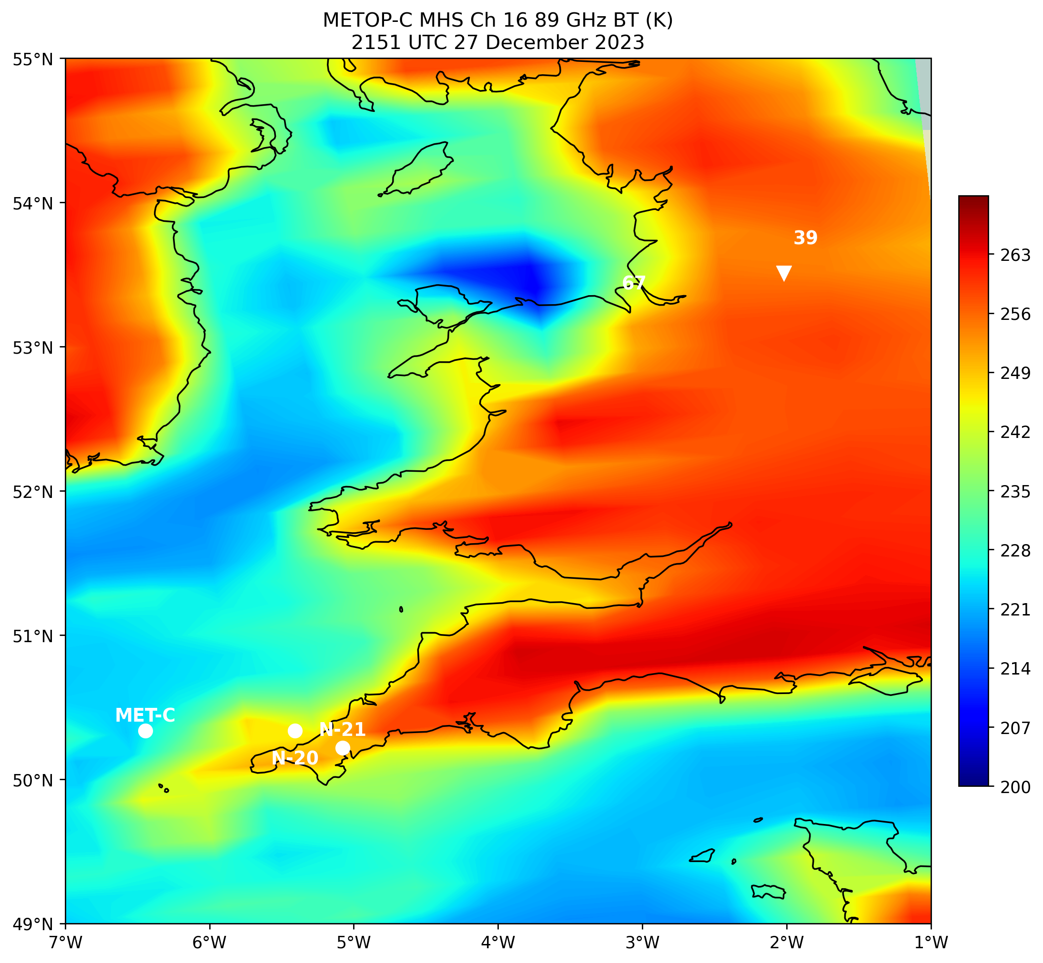
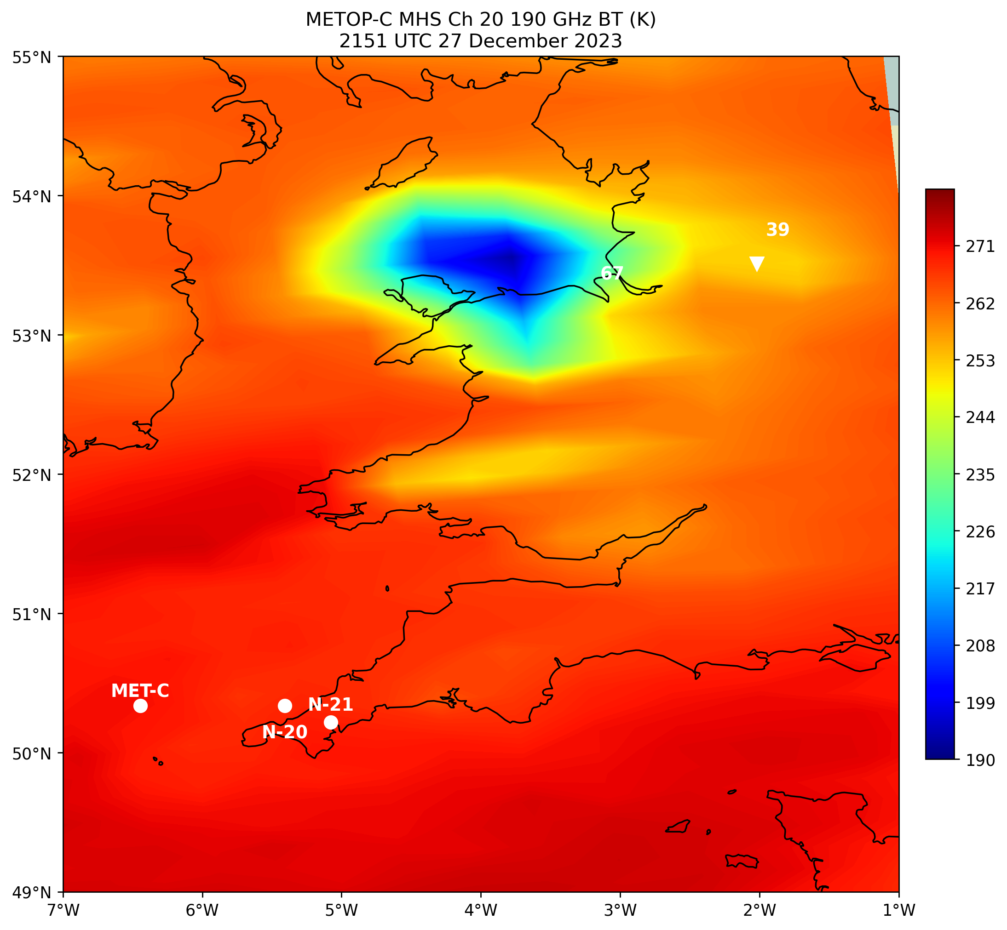
MCS
MCS

Slide 12
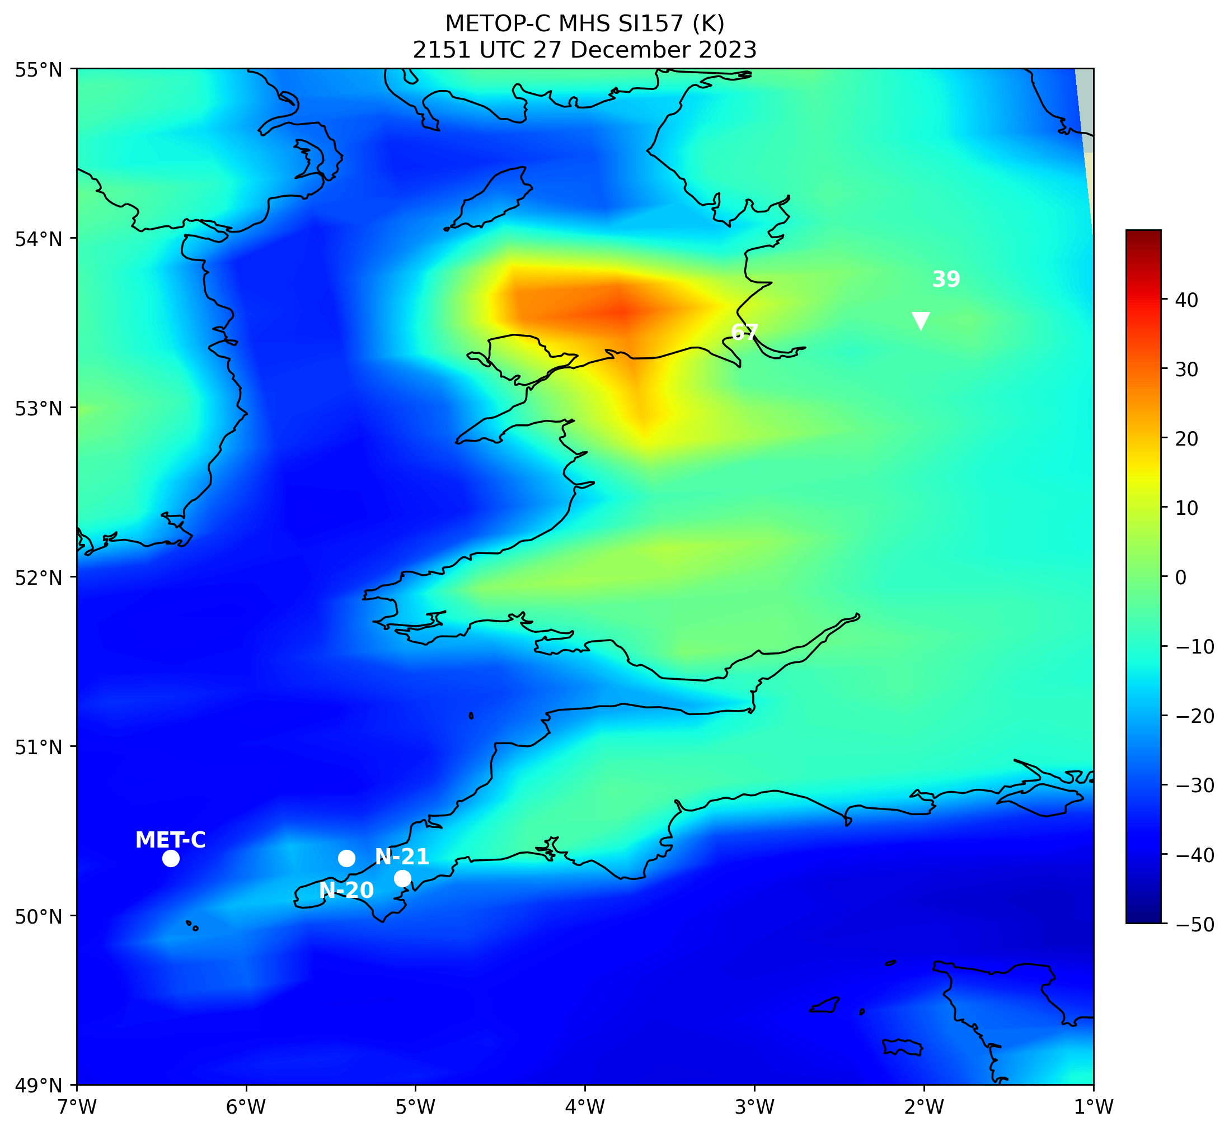
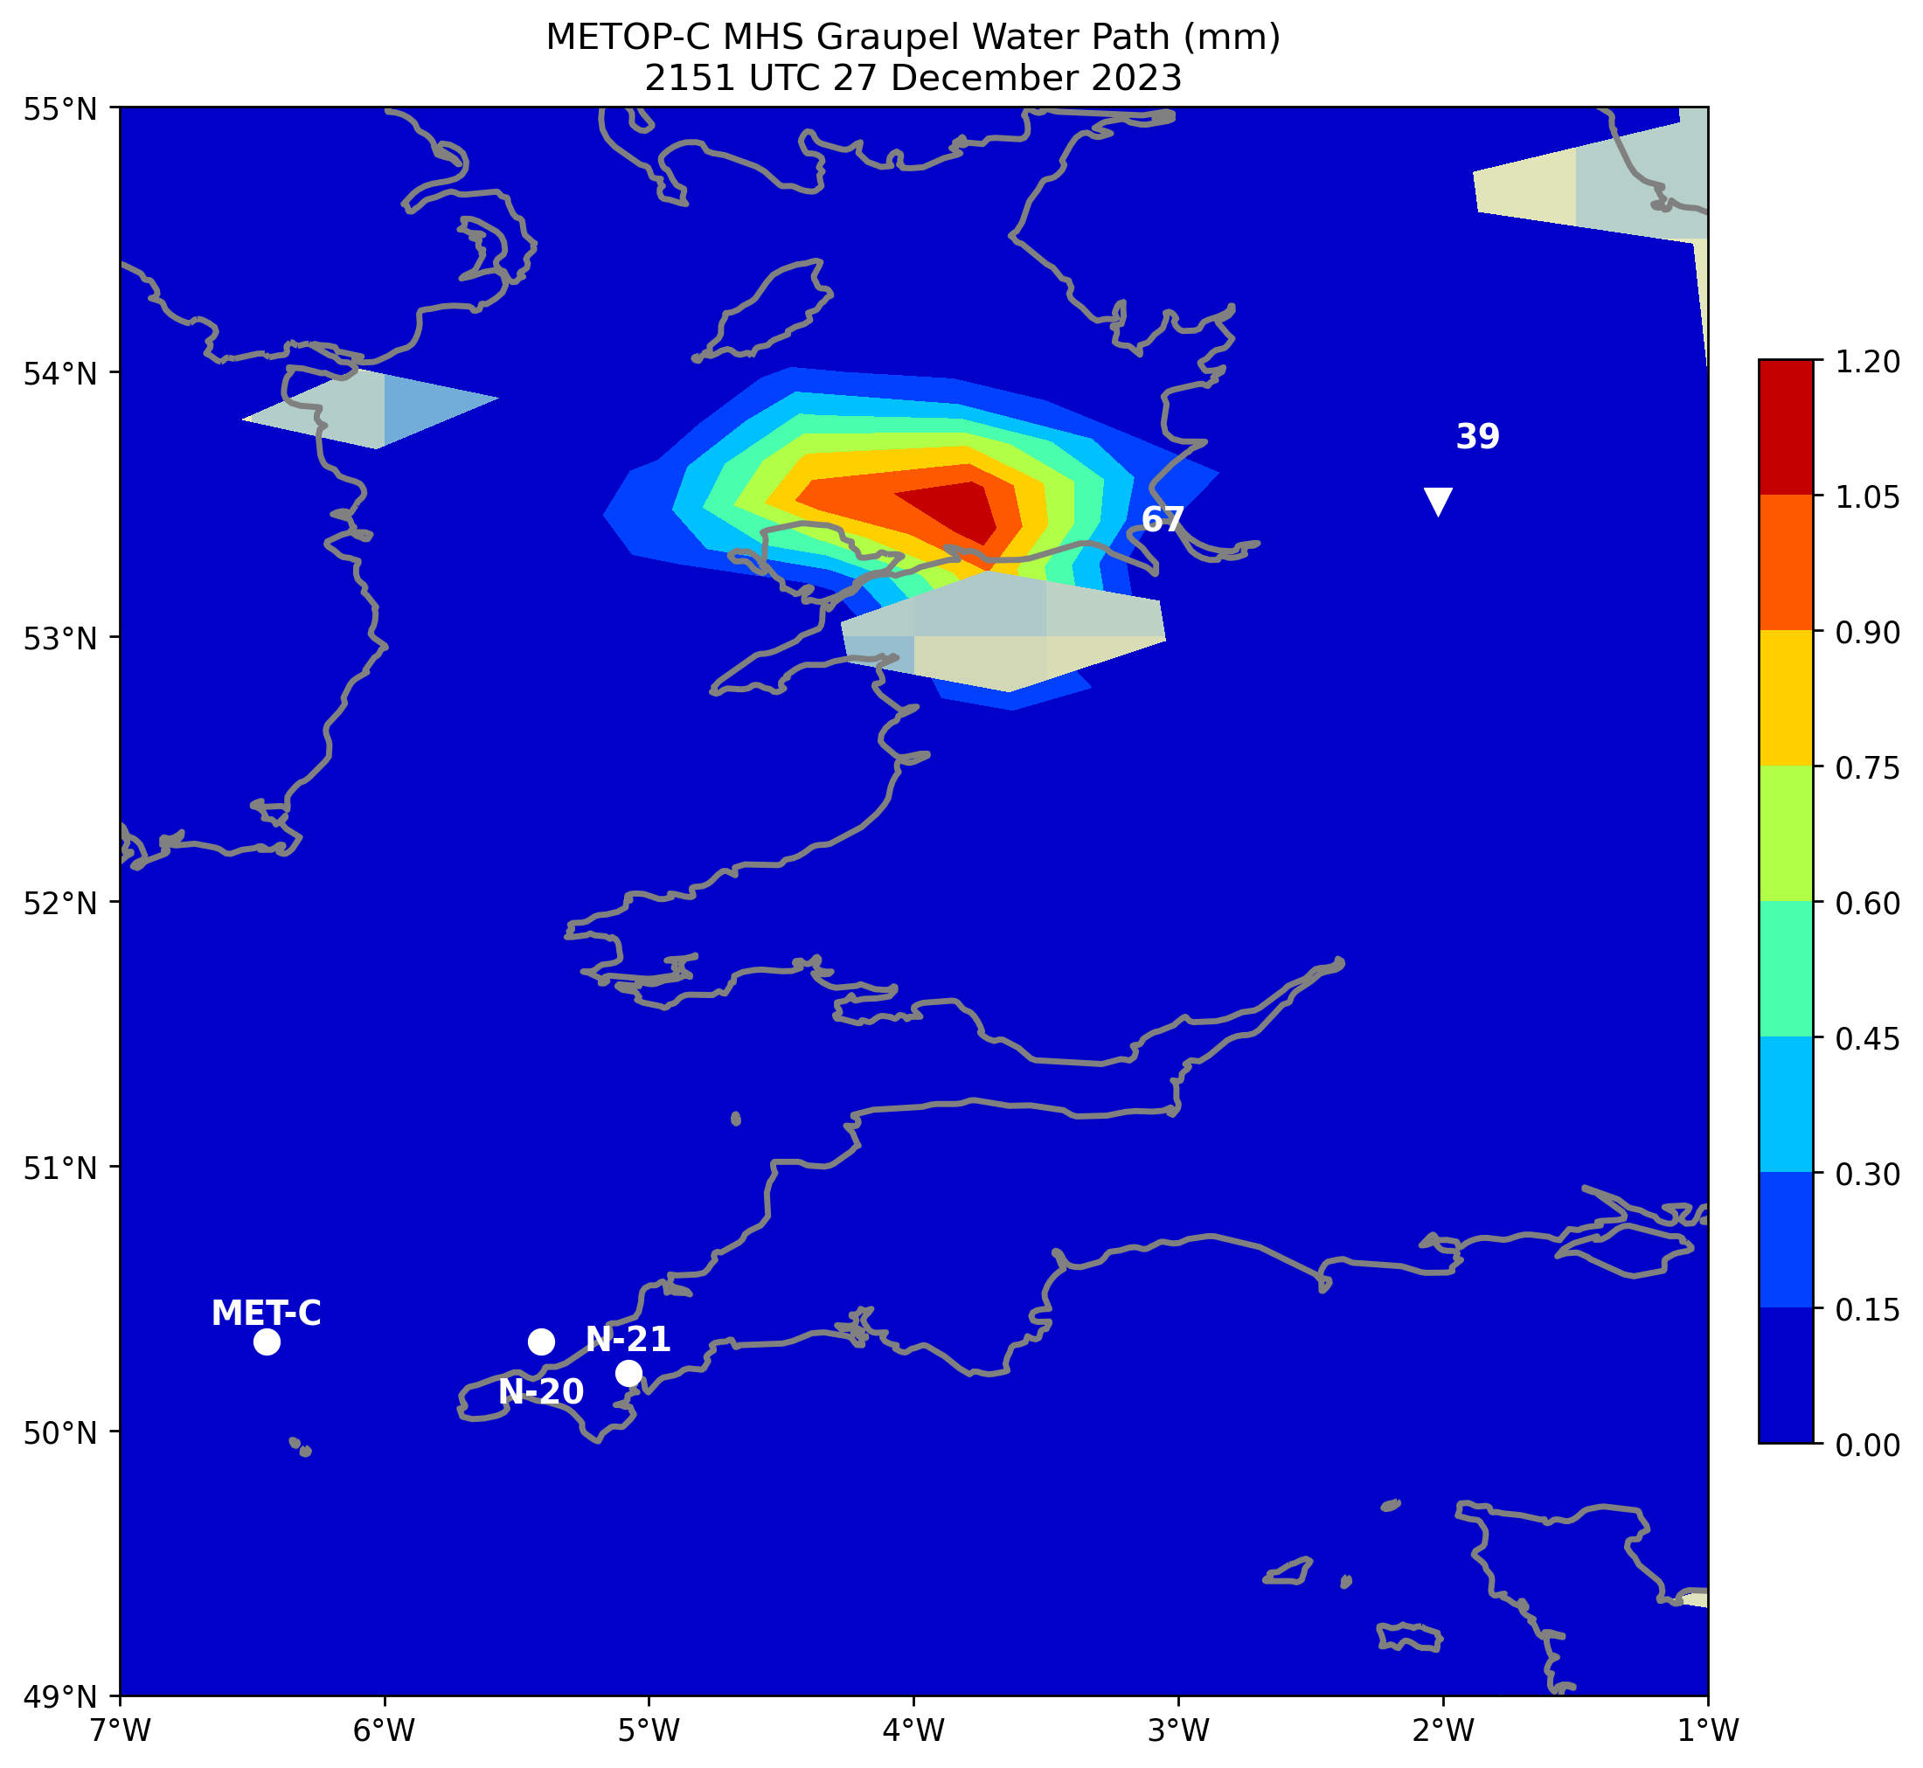
MCS
MCS

Slide 13
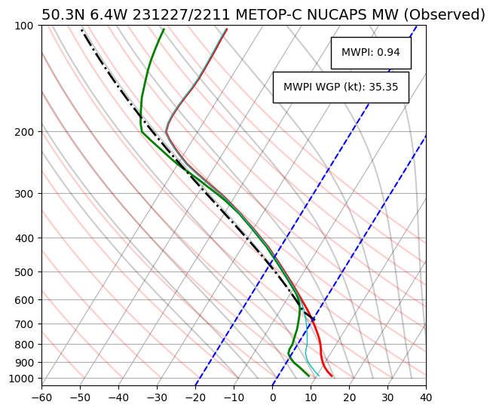
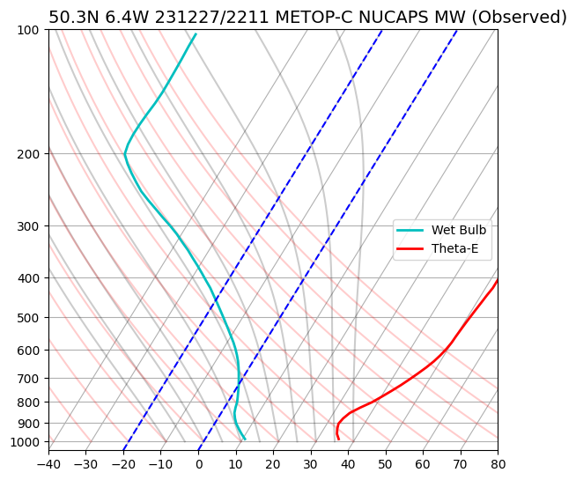
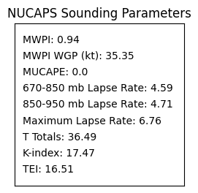
Wetbulb
θ_{e}
Conditional/potential instability
80 km WNW of Camborne, Cornwall, UK

Slide 14
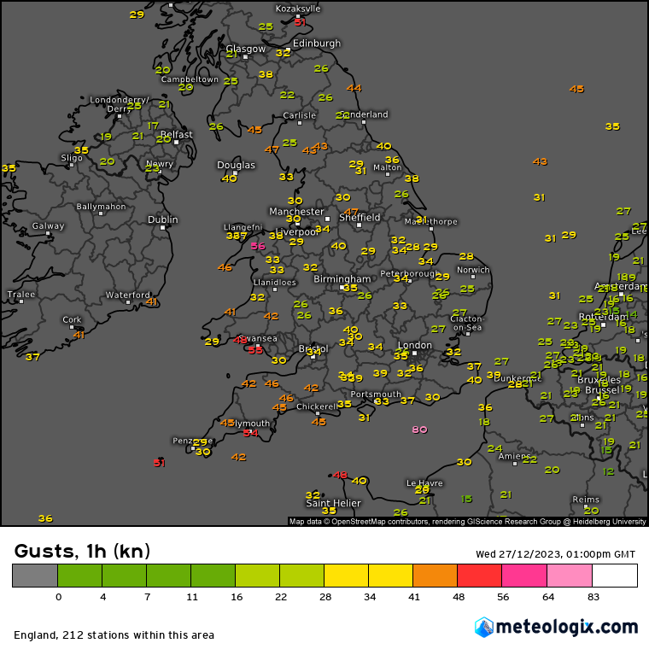
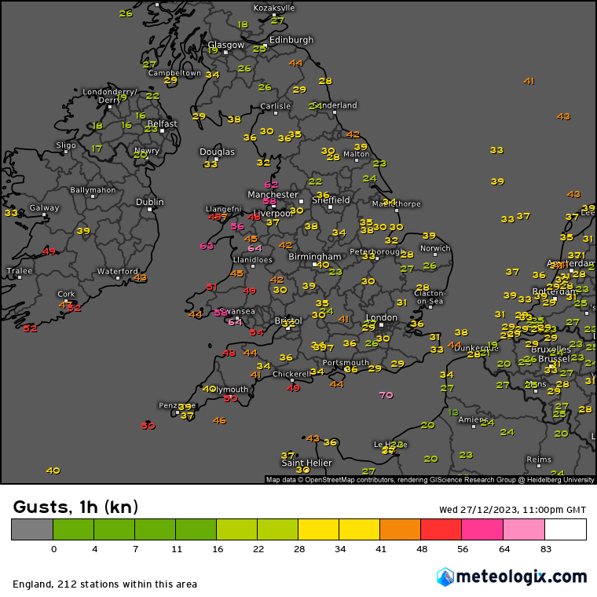

Slide 15
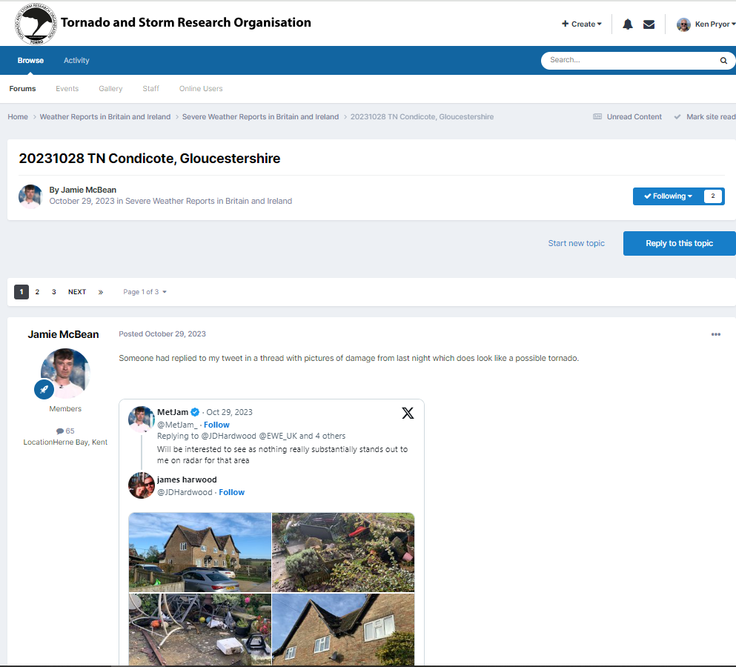
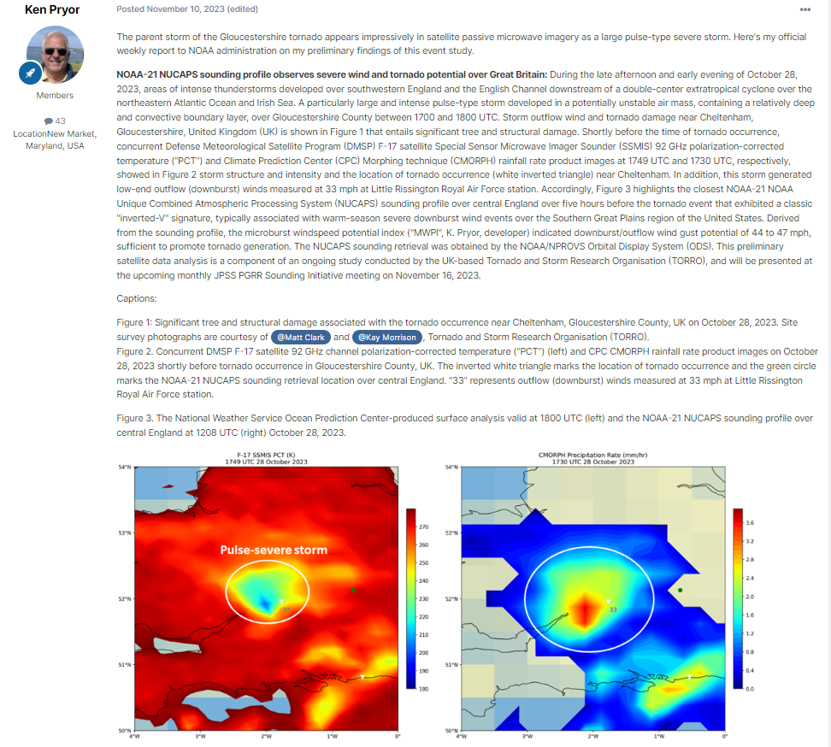
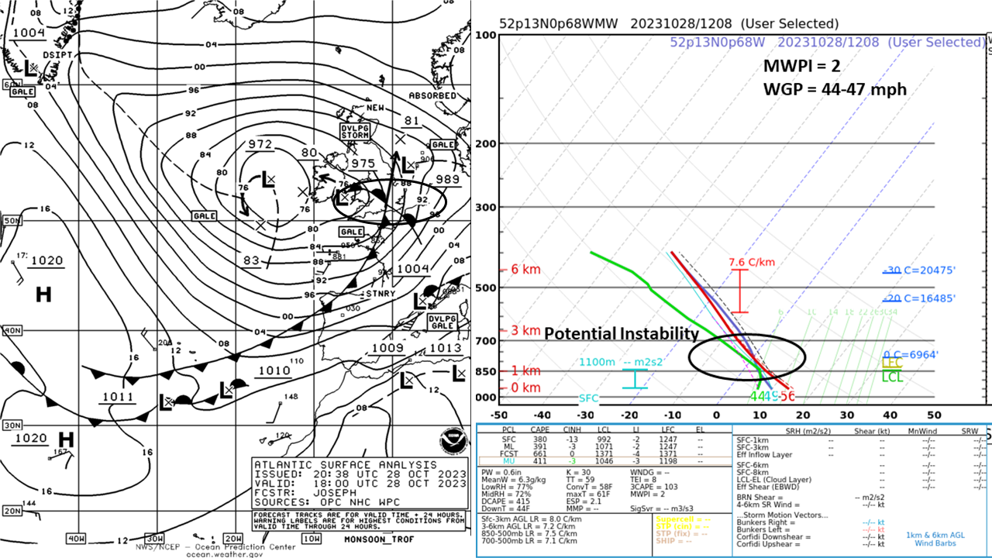
UKMET NUCAPS User Community
Olney, Buckinghamshire, UK
NOAA-21 NUCAPS sounding data obtained from NPROVS Orbital Display System (ODS).

Slide 16
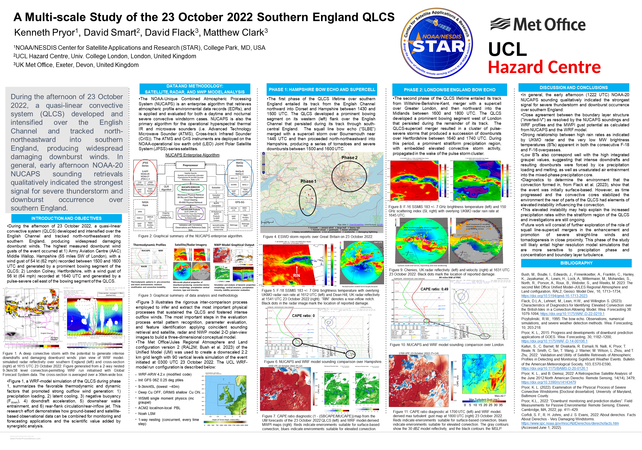
UKMET NUCAPS User Community
Attendance and Presentation
at the AMS 20th Conference on
Mesoscale Processes:
K. Pryor presented “A Multi-scale Study of the
23 October 2022 Southern England Quasi-linear
Convective System (QLCS)”.
The poster was viewed by scientists from
National Center for Atmospheric Research
(NCAR), University of Reading, UK, and
University of Melbourne, Australia, with an
Interest in NUCAPS sounding profiles of
temperature and moisture and LEO satellite
microwave image products.
Presented important study results of cool-
season elevated convective storm and
mesoscale convective system (MCS) development
over Great Britain and northwestern Europe.
This poster contributed to filling a knowledge
gap within the meteorological research
community by showcasing the effectiveness
of NUCAPS in severe storm environments.
https://ams.confex.com/ams/WAFNWPMS/meetingapp.cgi/Paper/424783

